Slide 1
Introduction to Human-Computer Interaction

Slide 2
Introduction
Human-Computer Interaction (HCI) is an interdisciplinary field connecting many disciplines such as computer science, psychology, and many other fields with the goal of making computing systems that are both useful and usable.

Slide 3



HUMAN COMPUTER INTERACTION
Human-computer interaction is a discipline concerned with the:
Design
Evaluation
Implementation
of interactive computing systems for human use and with the study of major phenomena surrounding them.

Slide 4
User Interface
The means by which the user and a computer system interact, in particular the use of input devices and software.
They help users interact with programs.
Users employ programs to perform and interact with tasks.

Slide 6
Design
A plan or drawing produced to show the look and function or workings of a building, garment, or other object before it is built or made.

Slide 7
Good Design
Good design brings joy to people.
It helps us do things we care about and helps us connect to people that we care about.
Good user interfaces can have a tremendous impact on both individuals' ability to accomplish things and society's as a whole.

Slide 8
Bad Design
Bad design costs time, money and lives.
Medical devices, industrial devices, airplane accidents and nuclear disasters are just a few domains where bad user interfaces have caused serious injury.

Slide 9
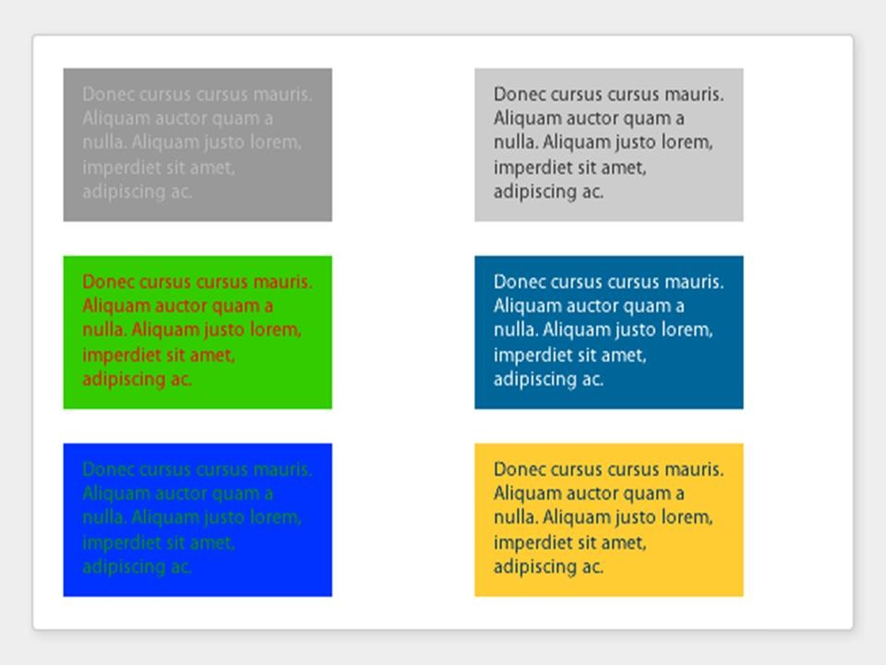

Slide 10
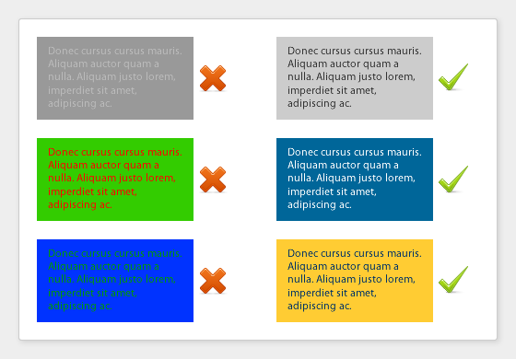

Slide 11
Measuring Cup
Users were asked :
How can you improve a measuring cup?
No one complained about measuring, but they watched people constantly add more in, over and over, until get the right amount. Stutter measuring.
Scott Klemmor hci-class.org

Slide 12
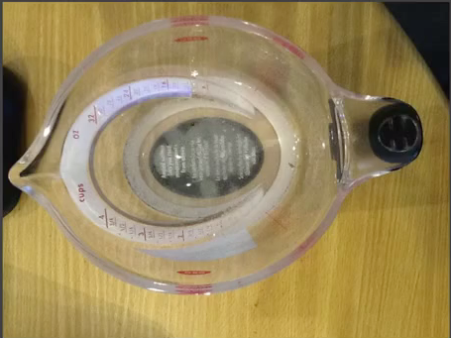
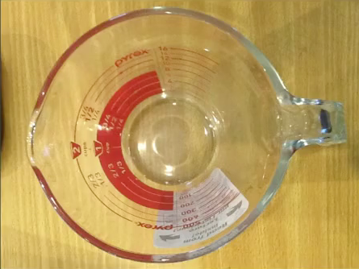
Improved Measuring Cups
Designed so you can read measurements from the top.

Slide 13
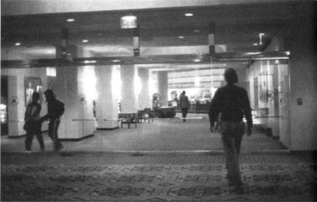
Doors
“But I shouldn't have trouble with doors and switches, water faucets and stoves. … I push doors that are meant to be pulled, pull doors that should be pushed, and walk into doors that should be slid …The answers should be given by the design, without any need for words or symbols, certainly without any need for trial and error.”
-Don Norman, Design of Everyday Things
Row of Swinging Glass Doors

Slide 14
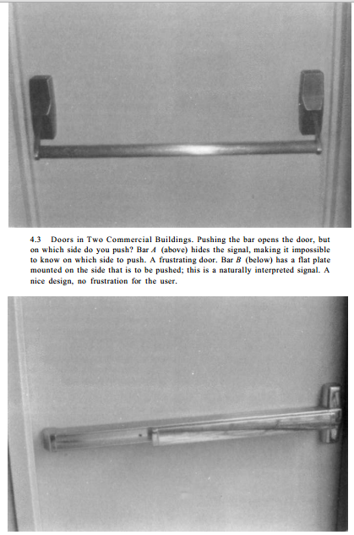
Bad and Good Doors
Bad Design – which side do you push?
Good design – no frustration for the user
*Design of Everyday Things
Notes:
, page 90

Slide 15
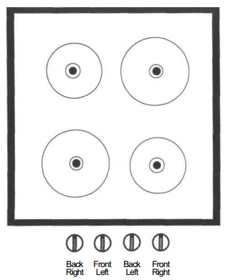
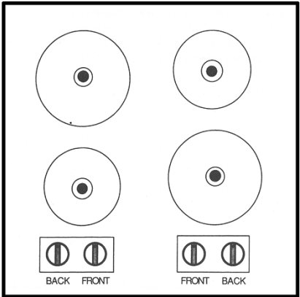
Stove
Bad arrangement of burners on stove:
Arbitrary
Paired
*Design of Everyday Things

Slide 16
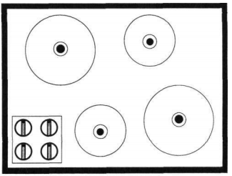
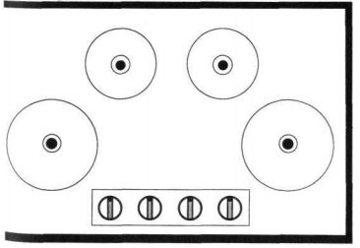
Stove, cont.
Better arrangement of burners on stove – No ambiguity.
*Design of Everyday Things
Notes:
Design of Everyday Things, page 77

Slide 17
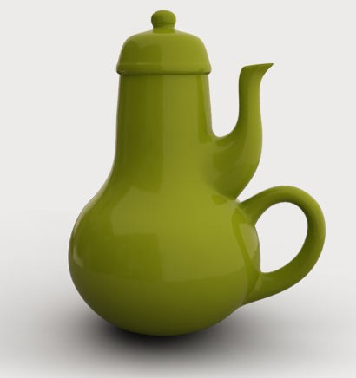
Poor Design
People blame themselves for their “stupidity” or “clumsiness” when making mistakes, especially if it is a simple task. People think they are mechanically incompetent.
Most accidents are attributed to human error.
However, many cases it is due to poor design.
It is not a user’s fault, but the designers!
Notes:
Artist – Carelman’s Coffeeepot for Masochists

Slide 18
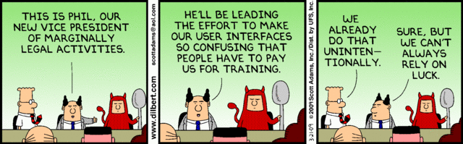
Lessons For the User
‘It is not your fault’ - When people have trouble with something it is not their fault, but the fault of the designer.
Try not to only criticize – think of a solution!
Observe!

Slide 19
Errors
Designer beware:
Assume all possible errors will occur
Design so as to minimize the chance of the error in the first place or its effects once it gets made.
Errors should be easy to detect, they should have minimal consequences and be reversible!

Slide 20
Accessibility
Users with physical challenges
Designers must plan early to accommodate users with disabilities
Older Adult Users
Including the elderly is fairly easy
Designers should allow for variability within their applications via settings for sound, color, brightness, font sizes, etc. with less distracting animation.

Slide 21
Determine user’s skill levels
“Know thy user”
Age, gender, physical and cognitive abilities, education, cultural or ethnic background, training, motivation, goals and personality
Design goals based on skill level
Novice or first-time users
Knowledgeable intermittent users
Expert frequent users

Slide 22
Why HCI?
With HCI, one can develop successful interactive products.
There are three ‘use’ words that must all be true for a product to be successful; it must be:
Useful- Accomplish what is required: play music, cook dinner, format a document;
Usable- Do it easily and naturally, without danger of error, etc.;
Used- Make people want to use it, be attractive, engage, fun, etc.

Slide 23
Human Computer Interaction
HCI is an interdisciplinary area, each with different emphasis:
Computer Science [Application design and engineering of human interfaces]
Psychology [The application of theories of cognitive processes and the empirical analysis of user behavior]
Sociology and anthropology [Interactions between technology, work, and organization]
Industrial Design [Interactive Products]

Slide 24
Human Computer Interaction
Cognition: The mental action or process of acquiring knowledge and understanding through thought, experience, and the senses.
Ergonomics: Is the study of how humans interact with manmade objects. The goal of ergonomics is to create an environment that is well suited to a user’s physical needs.
Usability: The effectiveness, efficiency and satisfaction with which specified users achieve specified goals in particular environments.

Slide 27
HISTORY OF HCI
1962 Sketchpad- Ivan Sutherland- PhD research in Electrical Engineering MIT.
Sketchpad was a graphics system that supported the manipulation of geometric shapes and lines (objects) on a display using a light pen.

Slide 28
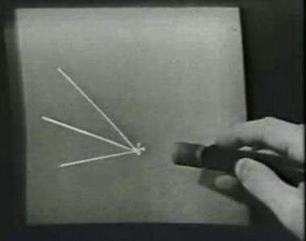
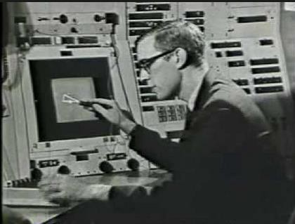
HISTORY OF HCI
▪
The Sketchpad Story

Slide 29
HISTORY OF HCI
1963 Invention of the mouse- Douglas Engelbart.
One device that symbolizes the emergence of HCI.
Fundamentally changed the way humans interact with computers.
Instead of typing commands, a user could manipulate a mouse to control an on-screen tracking symbol or cursor.

Slide 30
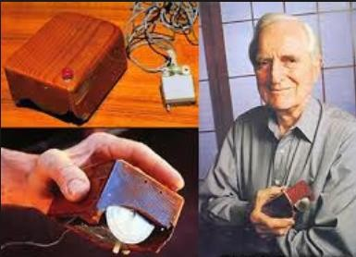
HISTORY OF HCI
1963 Invention of the mouse- Douglas Engelbart

Slide 31
HISTORY OF HCI
1981 Xerox 8100 Star Information System.
First Commercially released computer system with GUI.
It had windows, icon, menus, and a pointing device (WIMP).
It supported direct manipulation and what you see is what you get interaction. (WYSIWYG)
One novel feature of the Star was the use of Desktop Metaphor.
Metaphors are important in HCI.

Slide 32
HISTORY OF HCI
DESKTOP METAPHOR:
Unifying concepts used by Graphical user interfaces to help users interact more easily with the computer. The representation of familiar desktop items in a user interface to help make the capabilities of a computer clear.
Examples: File, Folder, Printer, etc.

Slide 33
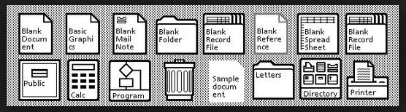
HISTORY OF HCI
Examples of icons appearing on the Xerox Star desktop.

Slide 34
HCI Professionals
Often HCI Professionals are called in too late.
A system has been designed and built and is now unusable so they ask how do we do it right.
Or companies think of it as testing – checking whether people can use it and fix problems rather than make sure they can from the beginning.
In the best companies, usability is designed in from the start.

Slide 35
End of Semester Goal:
“Now you are on your own. If you are a designer, help fight the battle for usability. If you are a user, then join your voice with those who cry for usable products. Write to manufacturers. Boycott unusable designs. Support good designs by purchasing them, even if it means going out of your way, even if it means spending a bit more. And voice your concerns to the stores that carry the products; manufacturers listen to their customers.
When you visit museums of science and technology, ask questions if you have trouble understanding. Provide feedback about the exhibits and whether they work well or poorly. Encourage museums to move toward better usability and understandability.
And enjoy yourself. Walk around the world examining the details of design. Take pride in the little things that help; think kindly of the person who so thoughtfully put them in. Realize that even details matter, that the designer may have had to fight to include something helpful. Give mental prizes to those who practice good design: send flowers. Jeer those who don't: send weeds.”
-Design of Everyday Things, Page 216-217
Notes:
DOIT: 2

